Slide 1

Factory Design Pattern
The Factory Design Pattern is a creational design pattern that provides a way to create objects without specifying the exact class of object that will be created. The pattern provides an interface or abstract class for creating objects, and allows subclasses to decide which class to instantiate. This pattern helps to create objects in a more flexible and maintainable way, as it allows you to add new object types without having to change the existing code.

Slide 2
Factory Design Pattern
The Factory Design Pattern is a creational design pattern that provides a way to create objects without specifying the exact class of object that will be created. The pattern provides an interface or abstract class for creating objects, and allows subclasses to decide which class to instantiate. This pattern helps to create objects in a more flexible and maintainable way, as it allows you to add new object types without having to change the existing code.

Slide 3
Factory Design Pattern
The Factory Design Pattern is a creational design pattern that provides a way to create objects without specifying the exact class of object that will be created. The pattern provides an interface or abstract class for creating objects, and allows subclasses to decide which class to instantiate. This pattern helps to create objects in a more flexible and maintainable way, as it allows you to add new object types without having to change the existing code.

Slide 4
Factory Design Pattern
The Factory Design Pattern is a creational design pattern that provides a way to create objects without specifying the exact class of object that will be created. The pattern provides an interface or abstract class for creating objects, and allows subclasses to decide which class to instantiate. This pattern helps to create objects in a more flexible and maintainable way, as it allows you to add new object types without having to change the existing code.

Slide 5
Factory Design Pattern
The Factory Design Pattern is a creational design pattern that provides a way to create objects without specifying the exact class of object that will be created. The pattern provides an interface or abstract class for creating objects, and allows subclasses to decide which class to instantiate. This pattern helps to create objects in a more flexible and maintainable way, as it allows you to add new object types without having to change the existing code.

Slide 6
Factory Design Pattern
The Factory Design Pattern is a creational design pattern that provides a way to create objects without specifying the exact class of object that will be created. The pattern provides an interface or abstract class for creating objects, and allows subclasses to decide which class to instantiate. This pattern helps to create objects in a more flexible and maintainable way, as it allows you to add new object types without having to change the existing code.

Slide 7
Here is an outline description of the Factory Design Pattern:
Define a factory interface or abstract class that declares a method for creating objects.
Create concrete classes that implement the factory interface or abstract class, each of which is responsible for creating a specific type of object.
Define a client that uses the factory to create objects, without having to know the specific class of object being created.
The client calls the factory method to create the object, which is returned as an interface or abstract class type.
The client then uses the object without knowing the specific class type, as the factory has created the object based on the parameters passed in.

Slide 8
Here is an outline description of the Factory Design Pattern:
Define a factory interface or abstract class that declares a method for creating objects.
Create concrete classes that implement the factory interface or abstract class, each of which is responsible for creating a specific type of object.
Define a client that uses the factory to create objects, without having to know the specific class of object being created.
The client calls the factory method to create the object, which is returned as an interface or abstract class type.
The client then uses the object without knowing the specific class type, as the factory has created the object based on the parameters passed in.

Slide 9
Here is an outline description of the Factory Design Pattern:
Define a factory interface or abstract class that declares a method for creating objects.
Create concrete classes that implement the factory interface or abstract class, each of which is responsible for creating a specific type of object.
Define a client that uses the factory to create objects, without having to know the specific class of object being created.
The client calls the factory method to create the object, which is returned as an interface or abstract class type.
The client then uses the object without knowing the specific class type, as the factory has created the object based on the parameters passed in.

Slide 10
Here is an outline description of the Factory Design Pattern:
Define a factory interface or abstract class that declares a method for creating objects.
Create concrete classes that implement the factory interface or abstract class, each of which is responsible for creating a specific type of object.
Define a client that uses the factory to create objects, without having to know the specific class of object being created.
The client calls the factory method to create the object, which is returned as an interface or abstract class type.
The client then uses the object without knowing the specific class type, as the factory has created the object based on the parameters passed in.

Slide 11
Here is an outline description of the Factory Design Pattern:
Define a factory interface or abstract class that declares a method for creating objects.
Create concrete classes that implement the factory interface or abstract class, each of which is responsible for creating a specific type of object.
Define a client that uses the factory to create objects, without having to know the specific class of object being created.
The client calls the factory method to create the object, which is returned as an interface or abstract class type.
The client then uses the object without knowing the specific class type, as the factory has created the object based on the parameters passed in.

Slide 12
Here is an outline description of the Factory Design Pattern:
Define a factory interface or abstract class that declares a method for creating objects.
Create concrete classes that implement the factory interface or abstract class, each of which is responsible for creating a specific type of object.
Define a client that uses the factory to create objects, without having to know the specific class of object being created.
The client calls the factory method to create the object, which is returned as an interface or abstract class type.
The client then uses the object without knowing the specific class type, as the factory has created the object based on the parameters passed in.

Slide 13


Slide 14
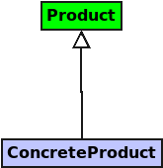

Slide 15
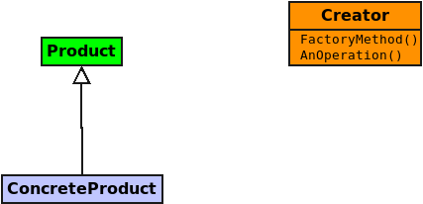

Slide 16
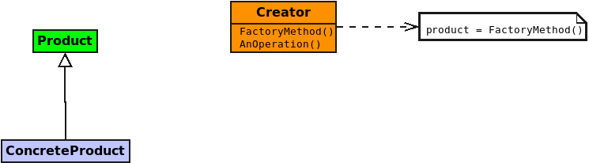

Slide 17
